Slide 1
Session 3: Motion Planning for Manipulators
May 2014
Jeremy Zoss
Sr. Research Engineer
Southwest Research Institute

Slide 2
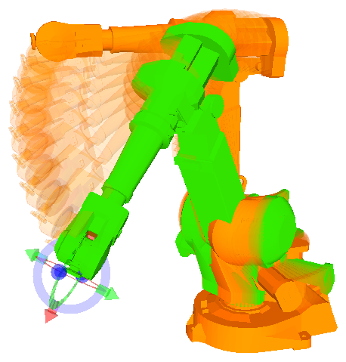
Outline
Overview
Motion Planning in ROS
HowTo: Set Up a New Robot
HowTo: Motion Planning using MoveIt!

Slide 3
Motion Planning in ROS

Slide 4

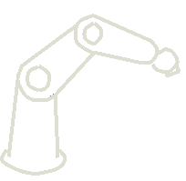
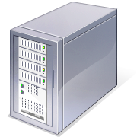
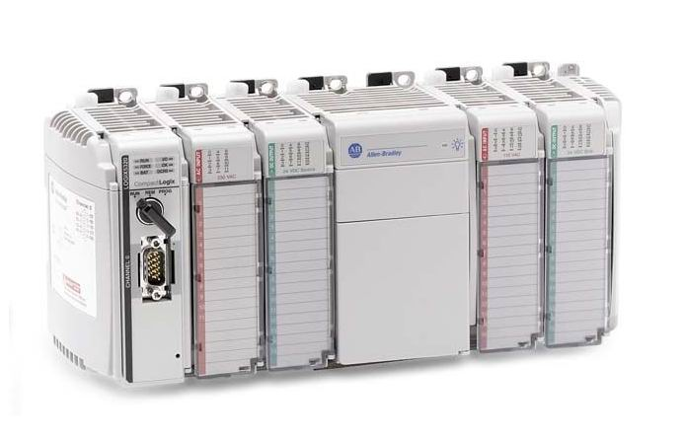
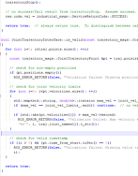
Motion Planning in ROS

Slide 5
Traditional Robot Programming
User Application
Robot Controller
Interpolate
Execute
Joint Move
J1
J2
J1
J2
Linear Move
P1
P2
P1
P2
Motion Types: limited, but well-defined. One motion task.
Environment Model: none
Execution Monitor: application-specific

Slide 6
ROS Motion Planning
Robot Controller
Execute
User Application
ROS Motion Planning
Move
Request
Start
Goal
Planning
Filtering
Motion Types: flexible, goal-driven, with constraints
but minimal control over actual path
Environment Model: automatic, based on live sensor feedback
Execution Monitor: detects changes during motion

Slide 7
Motion Planning Components
Interactive
(rviz plugin)
Motion Planning
Kinematics
ROS Actions
Robot
Path Planning
C++ API
Collision Checking

Slide 8
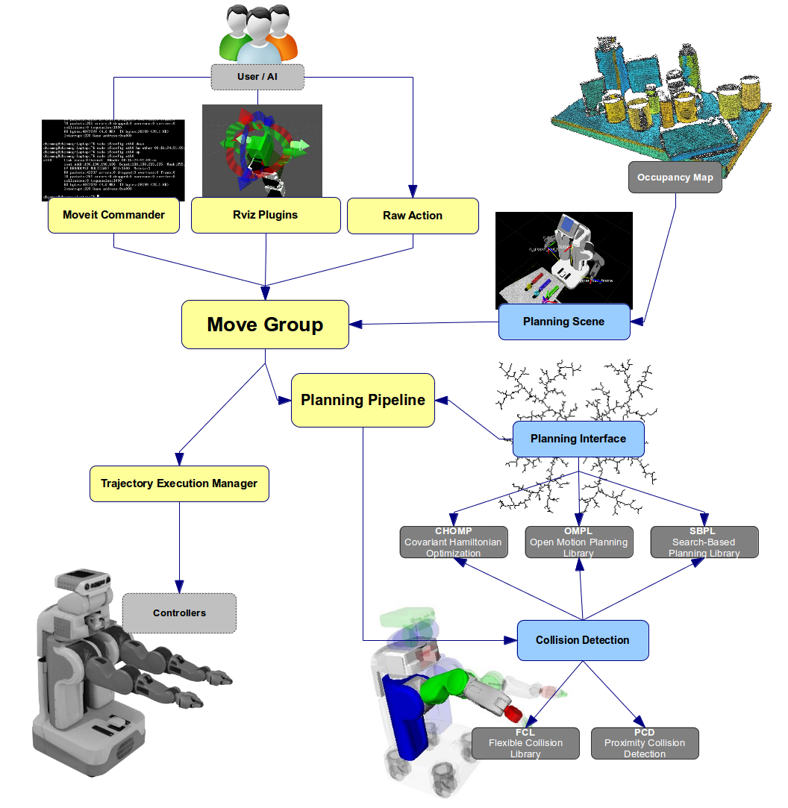
MoveIt Components
Sensor Input
http://moveit.ros.org/wiki/High-level_Overview_Diagram
http://moveit.ros.org/wiki/Pipeline_Overview_Diagram

Slide 9
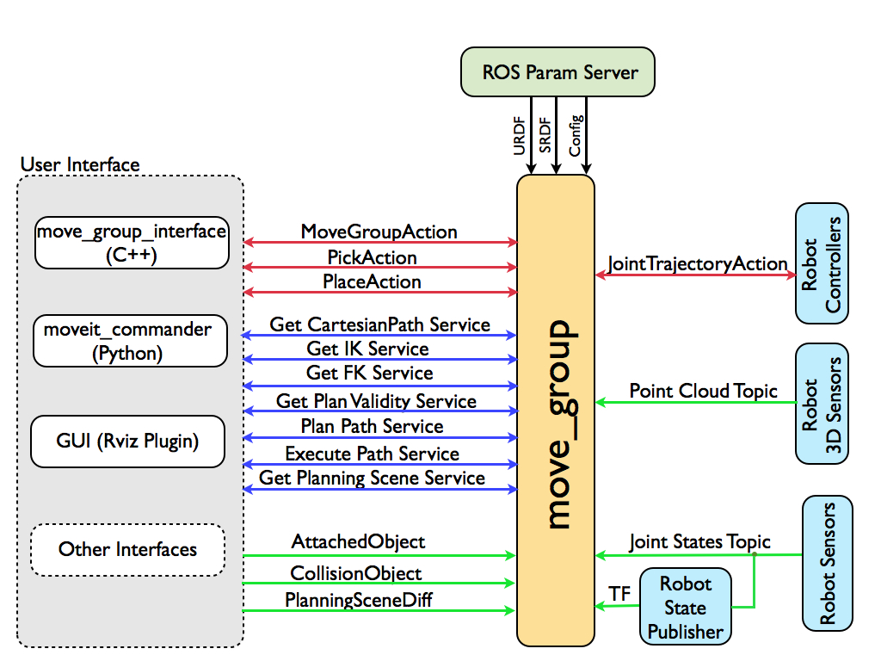
MoveIt Nodes
http://moveit.ros.org/documentation/concepts/

Slide 10
Arm Nav. vs. MoveIt!
Arm Navigation
Released in 2011
deprecated in Groovy
stable, but obsoleted
Multiple nodes (8)
extend by replacing nodes
Standard ROS Interfaces
messages, services, actions, ...
Somewhat slow
ROS comms. overhead
MoveIt!
Released in 2013
API still evolving
One node
component plugins
extend by replacing plugins
Multi-Interfaces
high-lvl API
C++ objects
messages, services, ...

Slide 11
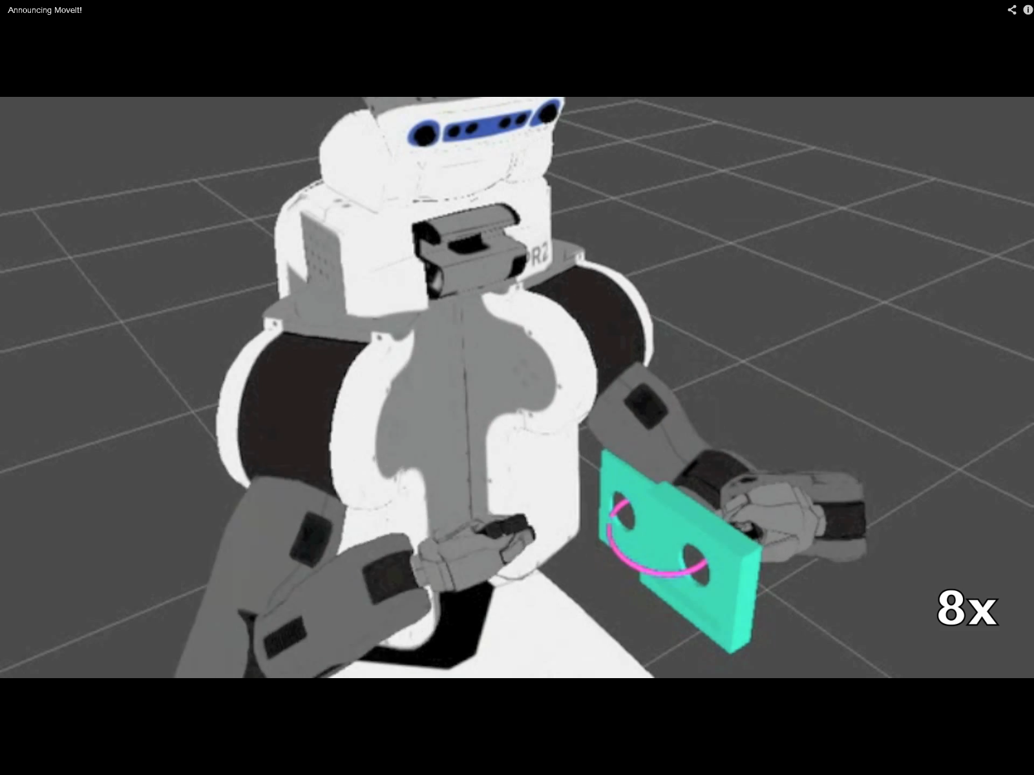
What Can MoveIt! Do?
http://www.youtube.com/embed/vAeEEoxVhAo?rel=0

Slide 12
MoveIt! / Robot Integration
A MoveIt! Package...
includes all required nodes, config, launch files
motion planning, filtering, collision detection, etc.
is unique to each individual robot model
includes references to URDF robot data
uses a standard interface to robots
publish trajectory, listen to joint angles
can (optionally) include workcell geometry
e.g. for collision checking

Slide 13
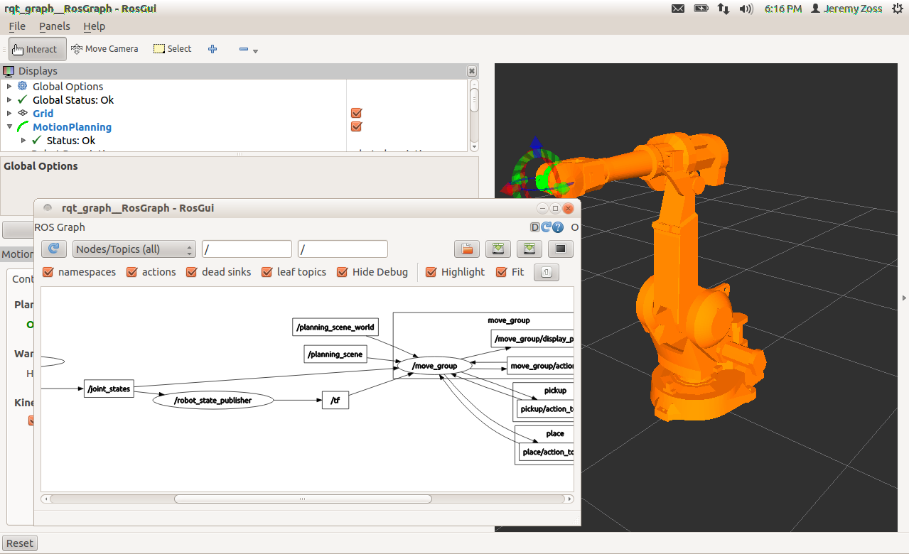
Exercise 3.1
Exercise 3.1:
Examining a Planning Environment

Slide 14
HowTo: Set Up a New Robot

Slide 15
Motivation
For each new robot model...
create a new MoveIt! package
Kinematics
physical configuration, lengths, etc.
MoveIt! configuration
plugins, default parameter values
self-collision testing
pre-defined poses
Robot connection
FollowJointTrajectory Action name

Slide 16
HowTo: Set Up a New Robot
Create a URDF
Create a MoveIt! Package
Update MoveIt! Package for ROS-I
Test on ROS-I Simulator
Test on “Real” Robot

Slide 17
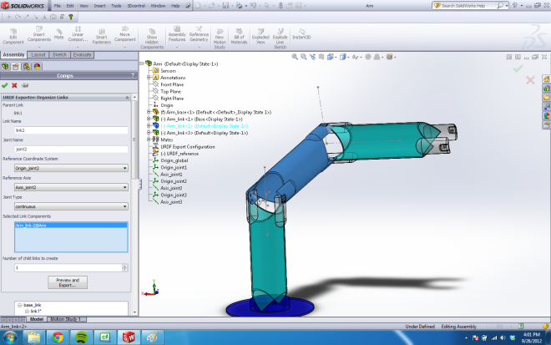
Create a URDF
Previously covered URDF basics.
Here are some tips:
create from datasheet or use Solidworks Add-In
double-check joint-offsets for accuracy
round near-zero offsets (if appropriate)
use “base_link” and “tool0”
use simplified collision models
convex-hull or primatives

Slide 18
Verify the URDF
It is critical to verify that your URDF matches the physical robot:
each joint moves as expected
joint-coupling issues are identified
min/max joint limits
joint directions (pos/neg)
correct zero-position, etc.

Slide 19
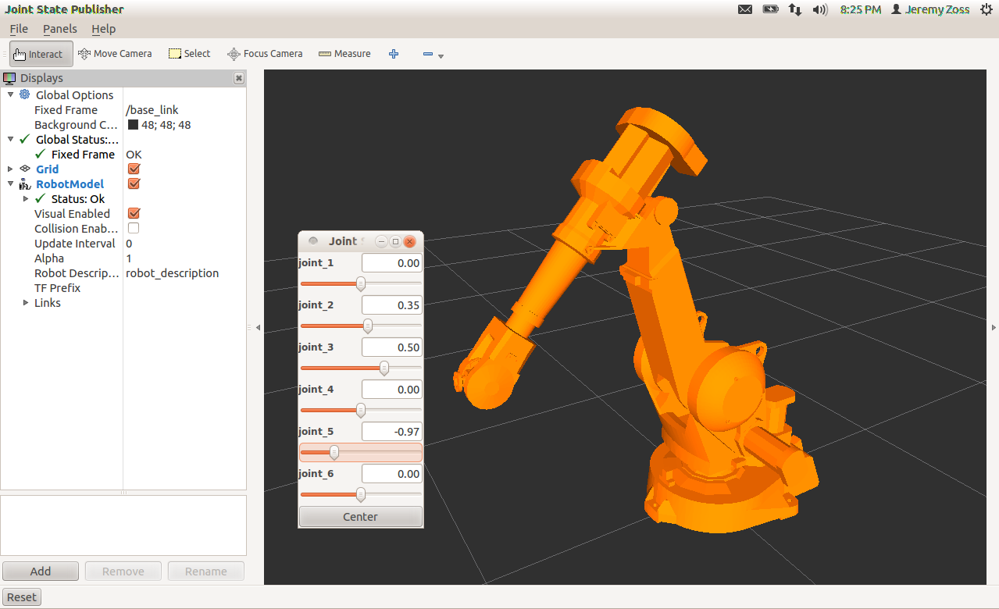
Exercise 3.2
Exercise 3.2:
Verify the robot URDF

Slide 20
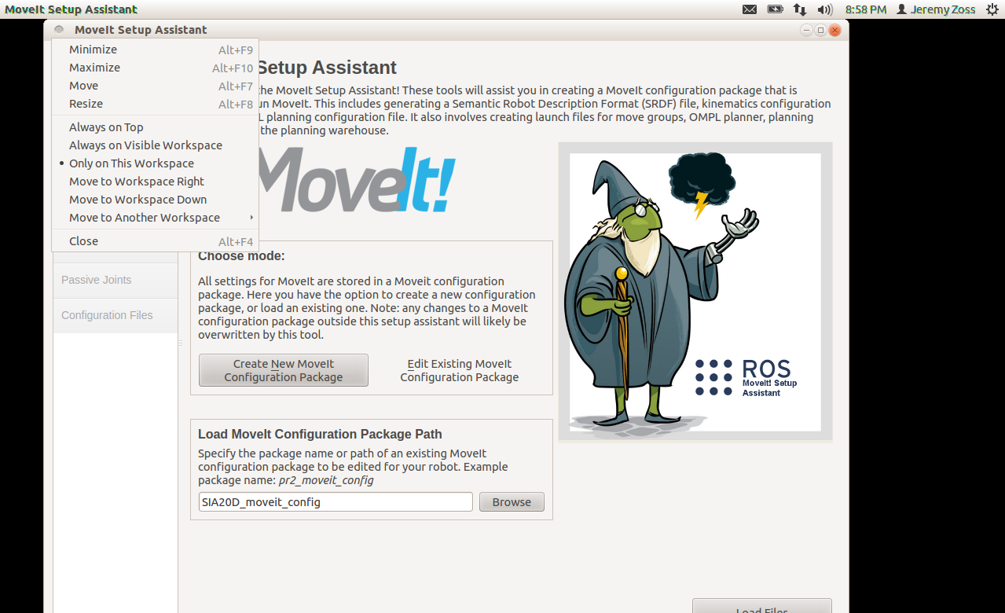
Create a MoveIt! Package
Use the MoveIt! Setup Assistant
can create a new package or edit an existing one

Slide 21
Exercise 3.3
Exercise 3.3:
Create a MoveIt! Package
stop before tutorial step 2.1 (Test MoveIt Package). We’ll do that later.

Slide 22
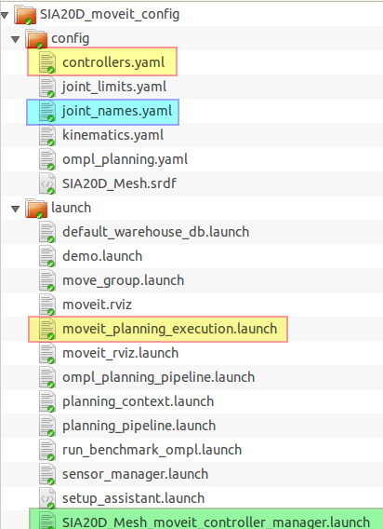
Update MoveIt! Package
Setup Assistant generates a generic package
missing config. data to connect to a specific robot
ROS-I robots use a standard interface

Slide 23
Update MoveIt! Package
We’ll generate launch files to run both:
simulated ROS-I robot
real robot-controller interface
ROS Industrial
FollowJointTrajectory Action
Industrial Robot Simulator
MoveIt!
Joint_Names,
Points
- Point 1
- Point 2
...
Joint Trajectory Action Server
Arm Nav.
Custom Path
Motion Interface
State Interface

Slide 24
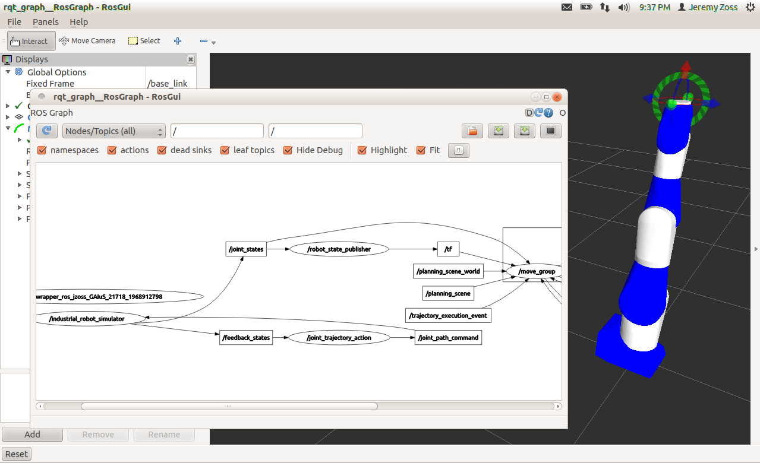
Exercise 3.4
Exercise 3.4:
Update the MoveIt! Package for ROS-I
SIA20D Joint Order:
S, L, E, U, R, B, T
SIA20D Substitutions:
[robot_moveit_config]
=> SIA20D_moveit_config
[robot_interface_pkg]
=> dx100
stop before tutorial step 3.1 (Test MoveIt Package). We’ll do that later.

Slide 25
HowTo: Motion Planning using MoveIt!
Motion Planning using RViz
Motion Planning using C++
Digging Deeper

Slide 26
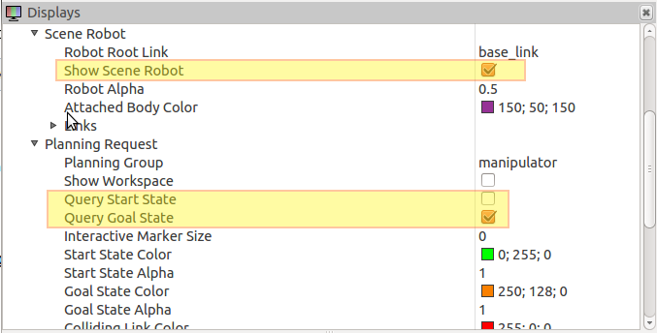
Motion Planning in RViz
Display Options

Slide 27
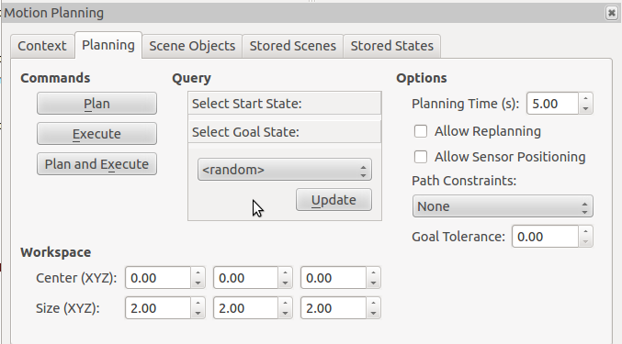
Motion Planning in RViz
Planning Options

Slide 28
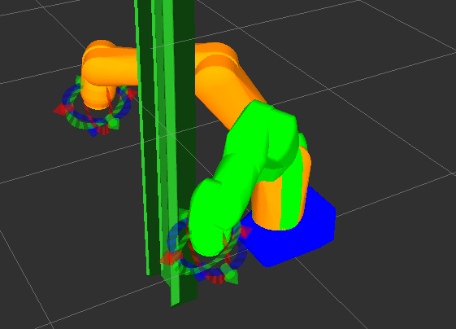
Exercise 3.5
Exercise 3.5:
Motion Planning using RViz

Slide 29
Motion Planning in C++
MoveIt! provides a high-level C++ API:
move_group_interface
#include <moveit/move_group_interface/move_group.h>
...
move_group_interface::MoveGroup group("manipulator");
group.setRandomTarget();
group.move();
Amazing!
3 lines = collision-aware path planning & execution

Slide 30
Reminder: MoveIt! Complexity
Sensor Input
http://moveit.ros.org/wiki/High-level_Overview_Diagram
http://moveit.ros.org/wiki/Pipeline_Overview_Diagram

Slide 31
Motion Planning in C++
Pre-defined position:
group.setNamedTarget(“home”);
group.move();
Joint position:
map<string, double> joints = my_function();
group.setJointValueTarget(joints);
group.move();
Cartesian position:
Affine3d pose = my_function();
group.setPoseTarget(joints);
group.move();

Slide 32
Behind the Scenes
FollowJointTrajectory Action
move_group_interface
MoveGroup Action
MoveIt!
move()
Start Pos,
Goal Pos,
Constraints,
...
move_group
Joint_Names,
Points
- Point 1
- Point 2
...
ROS-I
Joint Trajectory Action Server

Slide 33
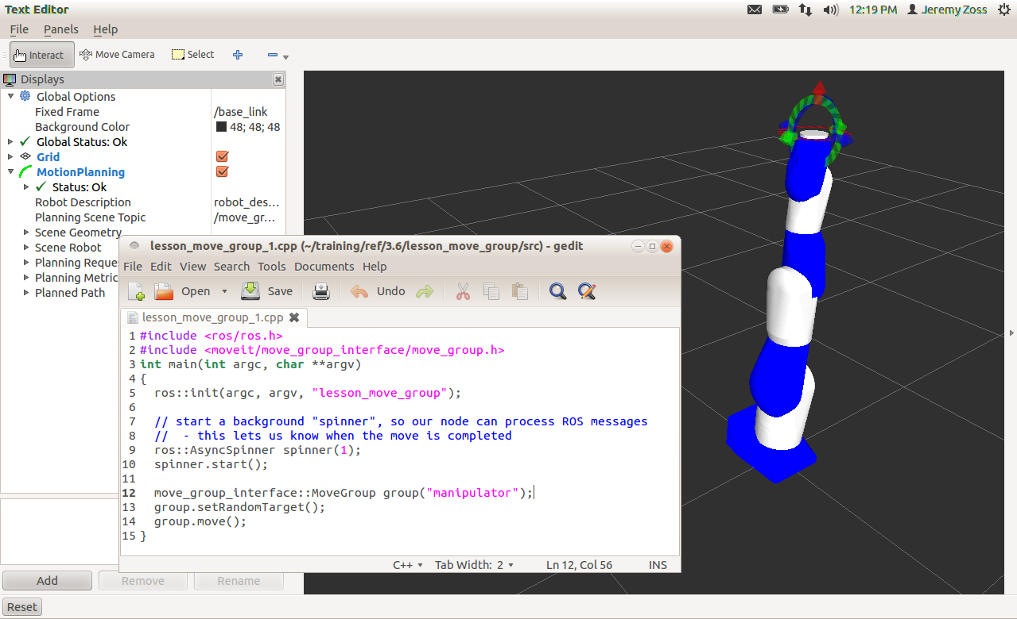
Exercise 3.6
Exercise 3.6:
Motion Planning using C++

Slide 34
Questions?
URDF
Setup Assistant
Robot Launch Files
RViz Planning
C++ Planning

Slide 35

Contact Info.
Jeremy Zoss
Sr. Research Engineer
SwRI
9503 W. Commerce
San Antonio, TX 78227 USA
Phone: 210-522-3089 Email: jzoss@swri.org
www.ROSindustrial.org

